Slide 1
Augmented Reality Innovations
Changing the learning environment for the deaf.
Lehi Alcantara
Michael Hughes
Kellie Kercher
Ian McGuire
Owen Riley
Meagan Steele
Notes:
We are the Augmented Reality Innovations team.
Our team includes Lehi, Kellie, Ian, Owen, Meagan and myself Michael.
Our coaches are Professor Helps and Professor Rowe
Our sponsors are Dr. Mike Jones and Dr. Jeannette Lawler
Our goal is to change the learning environment for the deaf

Slide 2
Summary
Project Overview
Scope
Key Components
Deliverables
Test Station
Demo
Project Management

Slide 3
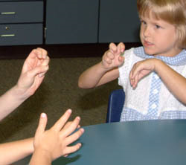
Project Overview
Purpose: To improve the learning environment for the deaf
Proposal: Develop a prototype that projects an ASL interpreter on augmented reality (AR) glasses
Design and build prototype to find optimal settings for AR Glasses

Slide 4
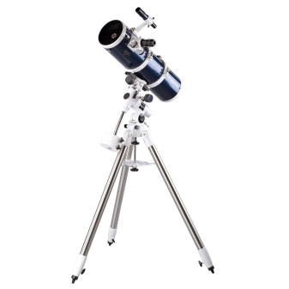
Our Scope
Development environment
Obtain AR glasses
Setup a dedicated server
Create software application
Create a working usability testing environment
Notes:
The scope of our project included creating a development environment where we could test the AR glasses and develop a software application to be used for testing. In the end we wanted to have a working usability testing environment where our customers could test the glasses with children to research the optimal settings for the interpreter inside the AR glasees.

Slide 5
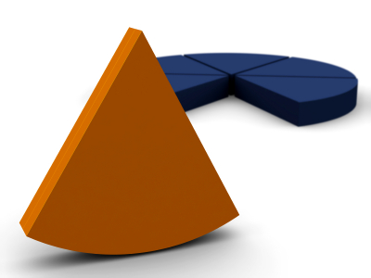
Beyond Our Scope
In-depth User Testing
Integration with Planetarium System
Provide Live ASL Interpretation
The Final Implementation
Notes:
Since this is the first year of a 3 year project, we kept these things in mind but did not include them in our work. In depth User Testing will be taking place starting this summer and through the next year to develop optimal settings. Integration with the Planetarium system. Currently there is not way for our system to provide Live ASL interpretation (only recorded videos).

Slide 6
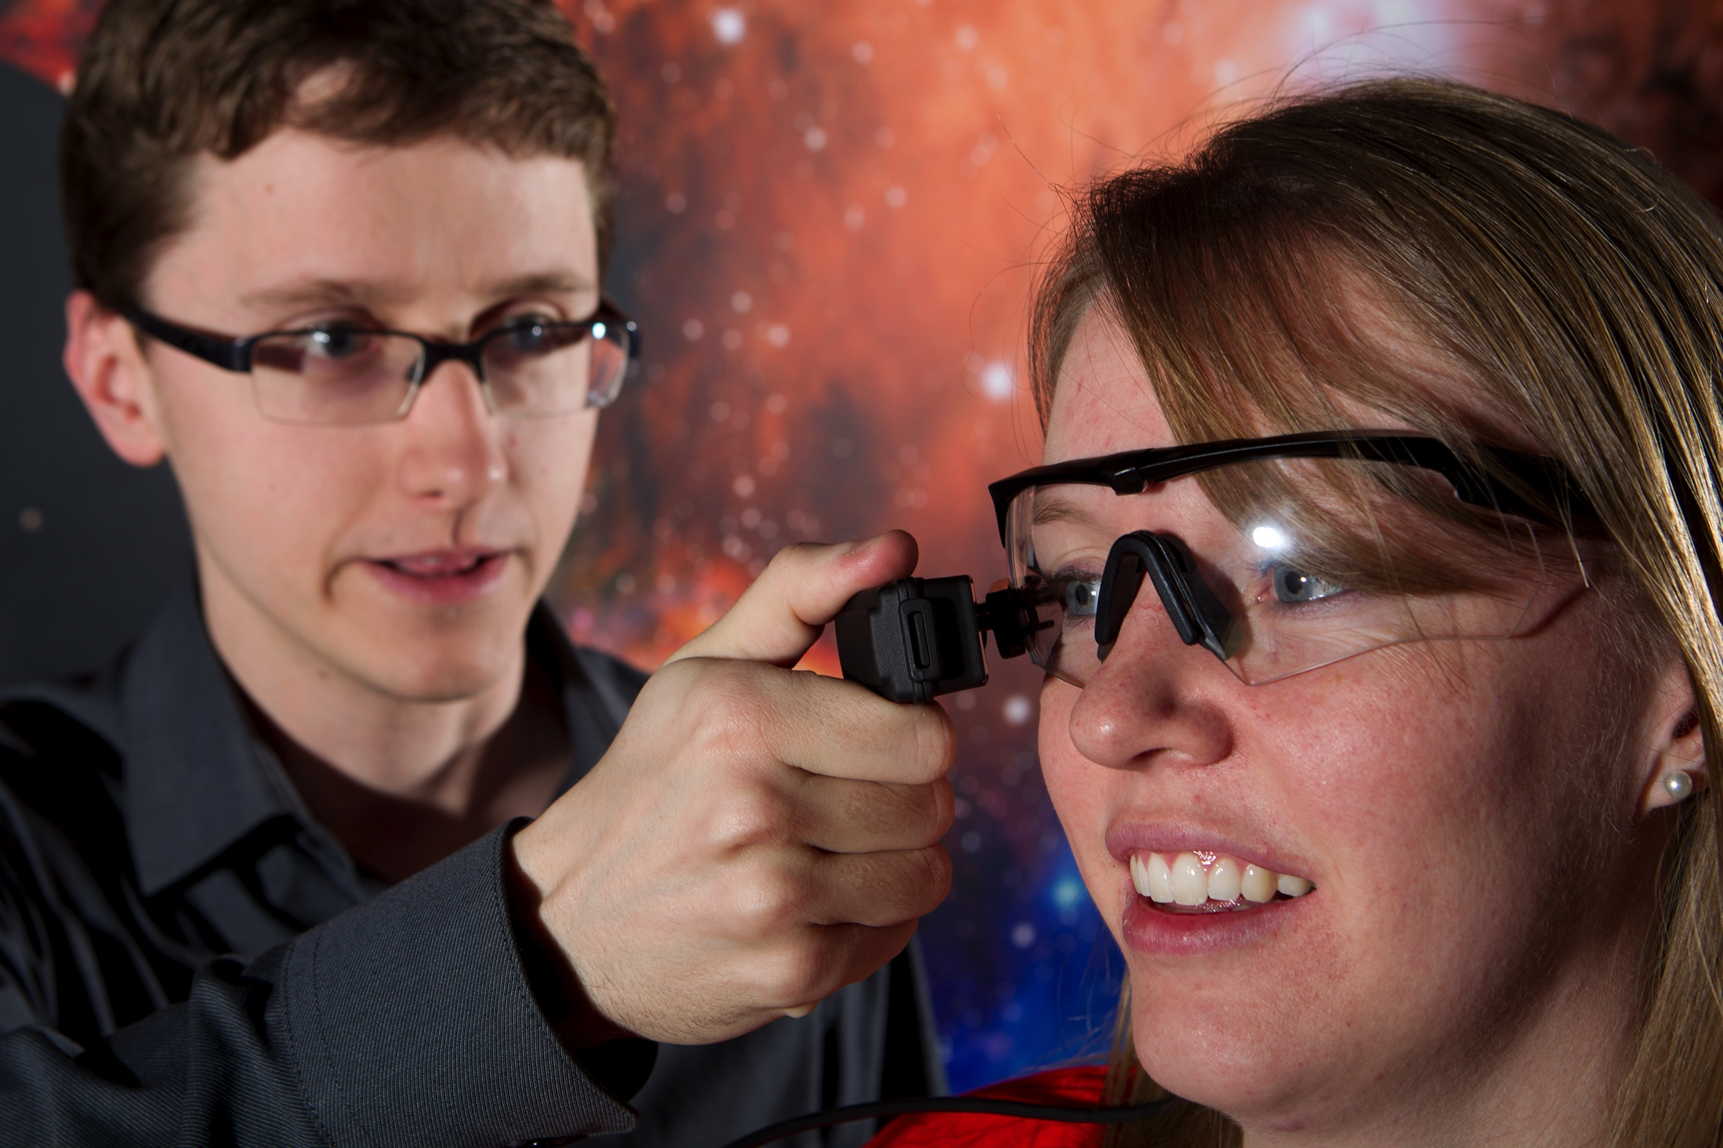
Deliverables
Prototype System
Integration of AR glasses and server
Software application
Logging capability
Documentation
Technical
User
Notes:
We are delivering:
UI
Video Control
Logging Script
Headset Suggestions

Slide 7


Key System Components
AR Glasses with ASL for User
Video for Testing
DirectX
Package
Development Environment:
Visual Studio
DirectX
UI for controlling ASL Video via Mouse
Server
Logging Capability
Zoom
Brightness
Contrast

Slide 8


Test Subject Perspective
Zoom
Brightness
Contrast

Slide 9
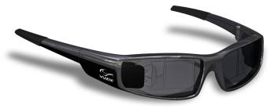
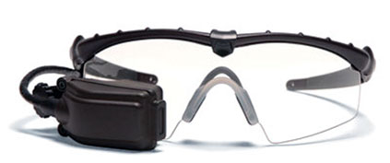
Chosen AR Display: Vuzix
Tac-Eye LT
Binocular Glasses
Child Suitable
Durable
Lightweight
Attaches to prescription and non-prescription glasses
High-contrast Display
‘ordinary-looking sunglasses’
Early summer

Slide 10
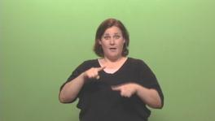
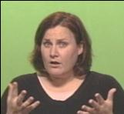
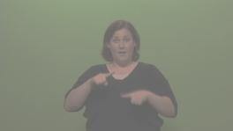
Optimizing User Settings
Many Control Variables for the Interpreter Video
Brightness
Zoom
Contrast
Position
Develop default settings for the Planetarium
API to be used for further software development
Open Framework

Slide 11
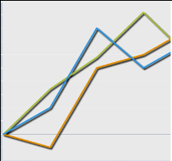
Logging the Settings
Stores data from sliders of the User Interface including:
Brightness
Zoom
Contrast
Position
Records time in video and time of day
Saves every 2 seconds
Saves to a CSV file

Slide 12
MFPlayer Demo

Slide 13
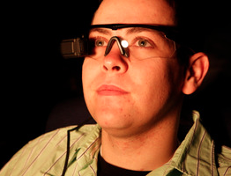
Testing Station
Vuzix Tac-Eye displays ASL video to the test subject
Second display shows a recorded Planetarium video
User Interface designed to permit test subject to adjust settings of the ASL video while not inhibiting view of Planetarium video

Slide 14
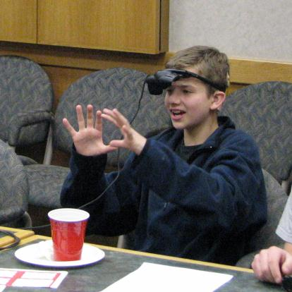
User Reactions to Prototype
Johnson Family
2 deaf children with Cochlear implants
Initial testing of glasses with these children and feedback about the project
User Testing with Hearing Children
Tested 9 children ages 7-12
Notes:
Meagan

Slide 15
Schedule (From Gantt Chart)
Accomplished
Research AR Glasses – Oct 9th
Order Glasses – Oct 24th
Obtain Server - Nov 4th
Prepare UI Video – Nov 11th
Obtained ASL Test Film– Nov 11th
Select Development Platform – Nov 14th
Install test API software – Nov 22nd
Headsets Expected – Dec 5th
Design UI – Jan 9th
Verify Designs with Customer – Jan 13th
Test Compatibility of Glasses with Server – Feb 17th
First Focus Group – Feb 18th
Implement UI Changes – Feb 24th
Finalize UI with customer – March 17th
Code and Implement video image controls – March 22th
Second Focus Group– March 24th
Complete adjustments to system – April 5th
Client training and handover– April 11th

Slide 16
Funding and Resources
NSF Funding $14,693 + IAB $250 + Department Funding
Acquired Resources:
$3,500 – AR Glasses for Testing
$1,699 – Backup AR Glasses
Donated by Customer – Server Laptop
Expenditure and Other Resources Acquired
Time and Resources donated by KBYU - filming
Free for Microsoft Users – Microsoft Media Foundation
Free for IT students from MSDNAA – Visual Studio
$120 – Focus Group compensation
Future Expenditure:
$10,000 – interpreters
$2,500 – Project recruiting and compensation

Slide 17
Future Development
3 Year Project
Testing
Lab testing with targeted users
Planetarium testing
Planetarium Use
Implement prototype in planetarium
1
2
3

Slide 18
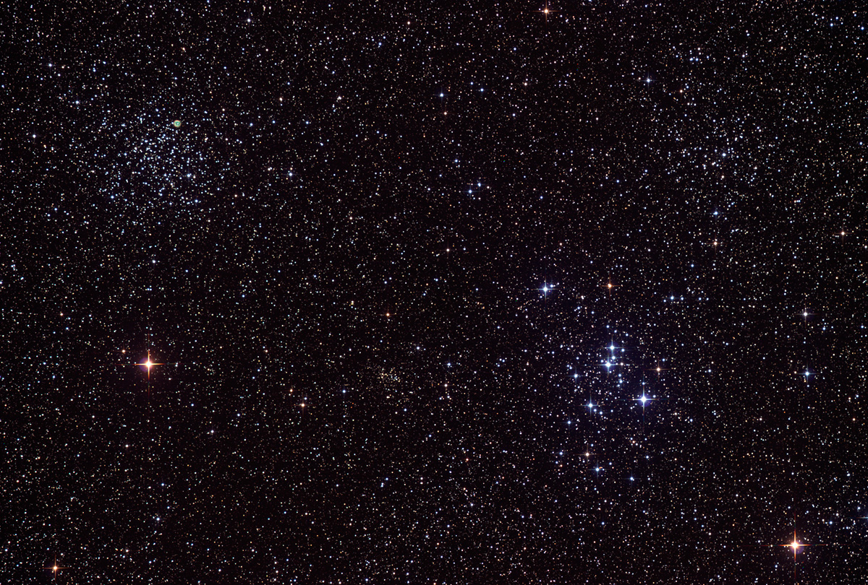

Questions?

